Slide 1
AVIATION PERFORMANCE METRICS
Kaushal Patel Group: 2
Tathagata Dutta
Qilun Lyu
(under the supervision of DR. James Abello, Fangda Han and Nishant Kumar)

Slide 2
Data Description
Source
Downloaded from Bureau of Transportation Statistics.
The data is at rest.
Coverage
All 50 US States, e.g. NJ
Including Puerto Rico & U.S. Virgin Islands & U.S. Pacific Trust Territories and Possessions
Excluding Washington D.C.
Timespan
The data is time variant as it ranges from January 2015 to December 2019.
Size
Raw data: 13-14GB in csv format.
>31 million records
Storage
The source data is imported into MySQL, we use InnoDB Engine.

Slide 3
Questions
Airline with most/least delay
Time of day, day of week, month of year having most delays
Factors behind delayed departures/arrivals for Airlines (eg. Weather, Security, Carrier, etc.)
Cancellation rate of airports
Delay in routes

Slide 4
End Users
Passengers/Consumers
Airport authorities
Airline Companies

Slide 5
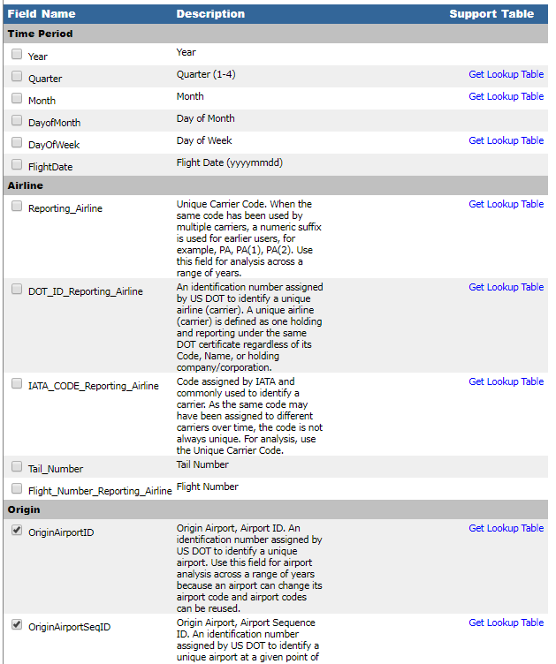
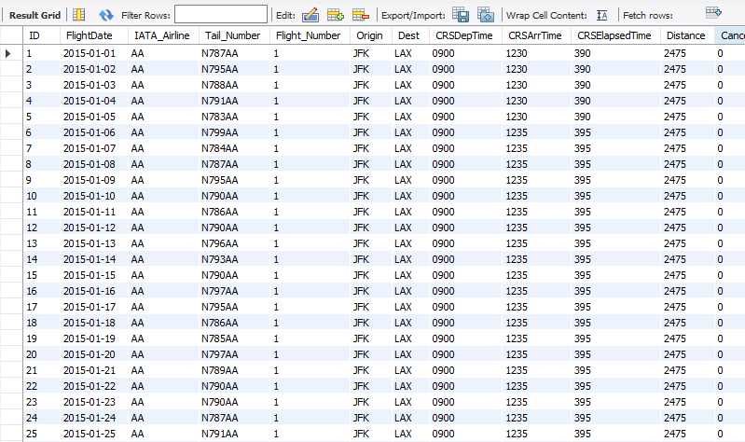
Data Dictionary & Data Snippet

Slide 6
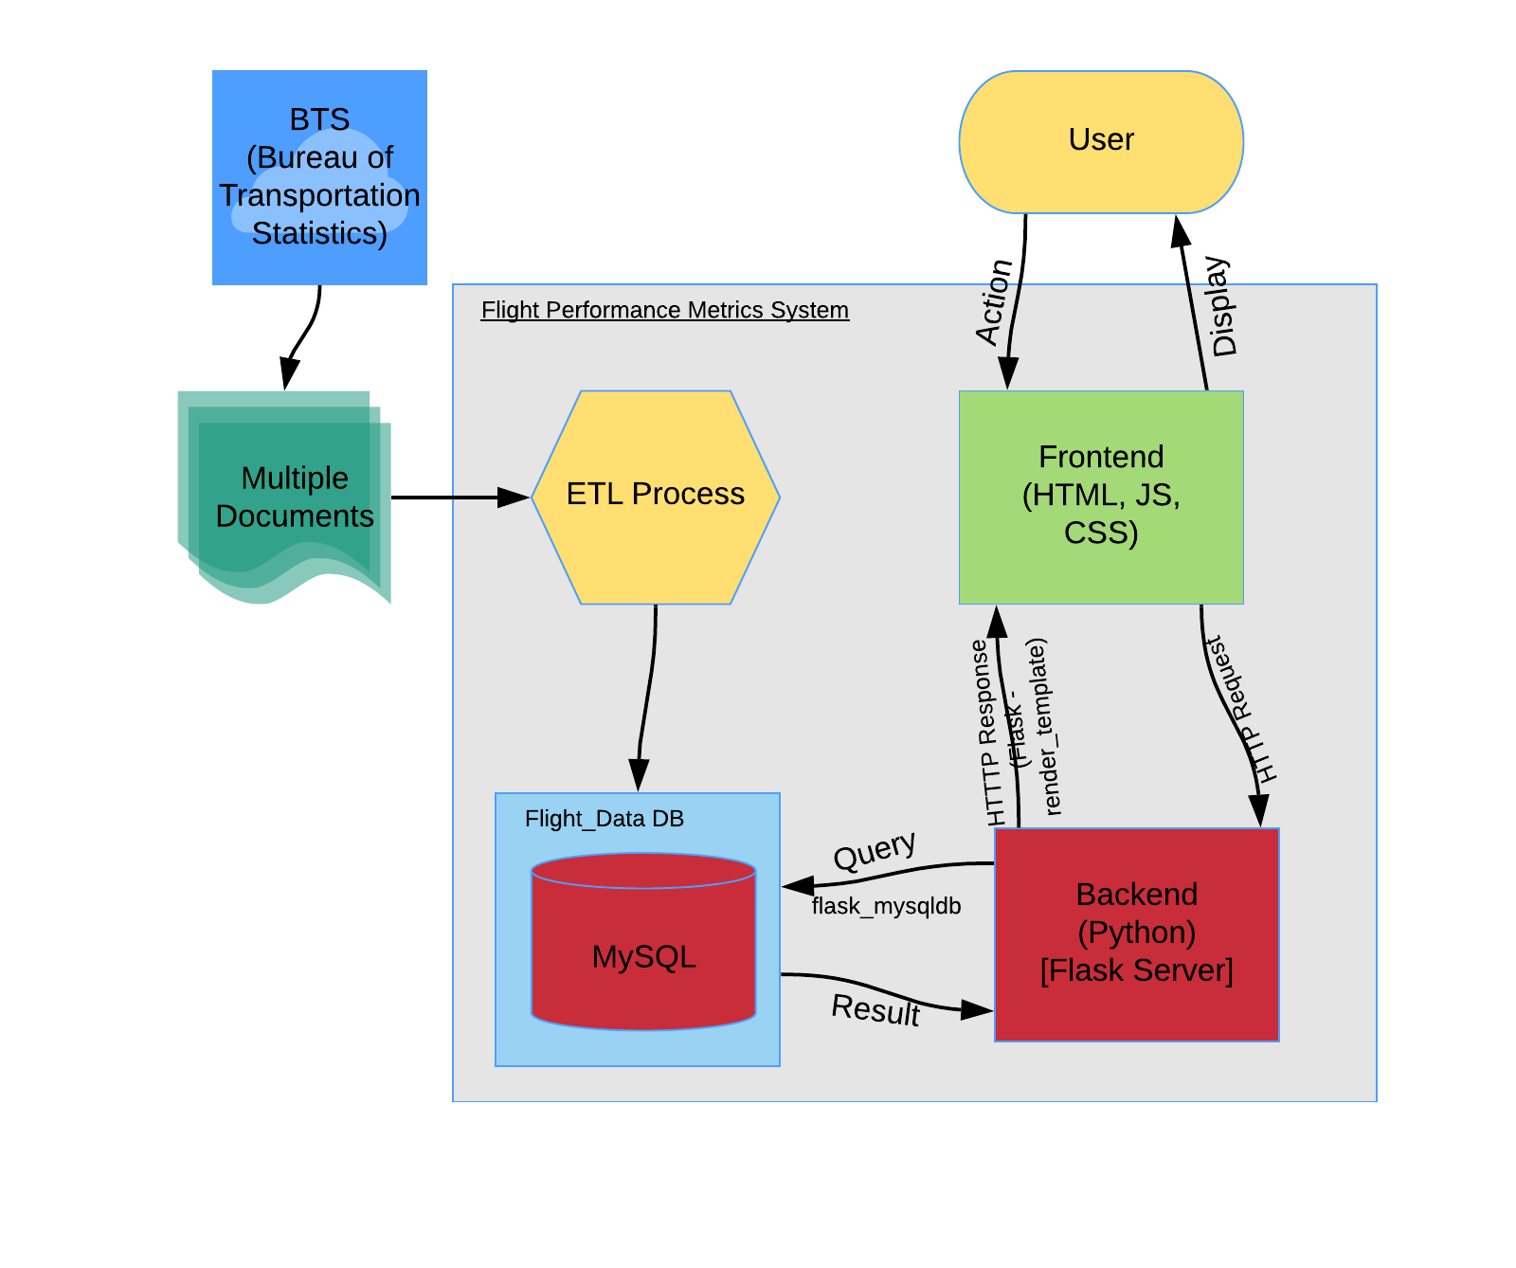
System Flow Diagram

Slide 7
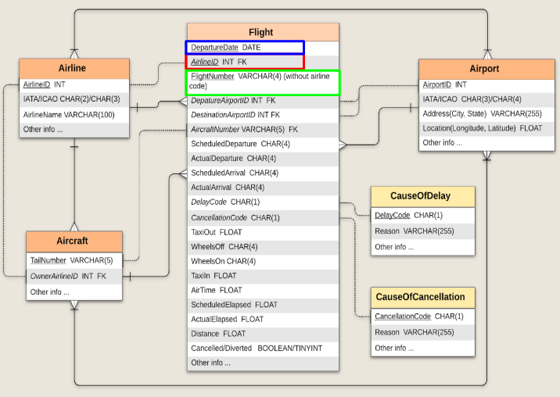
ER Diagram

Slide 8
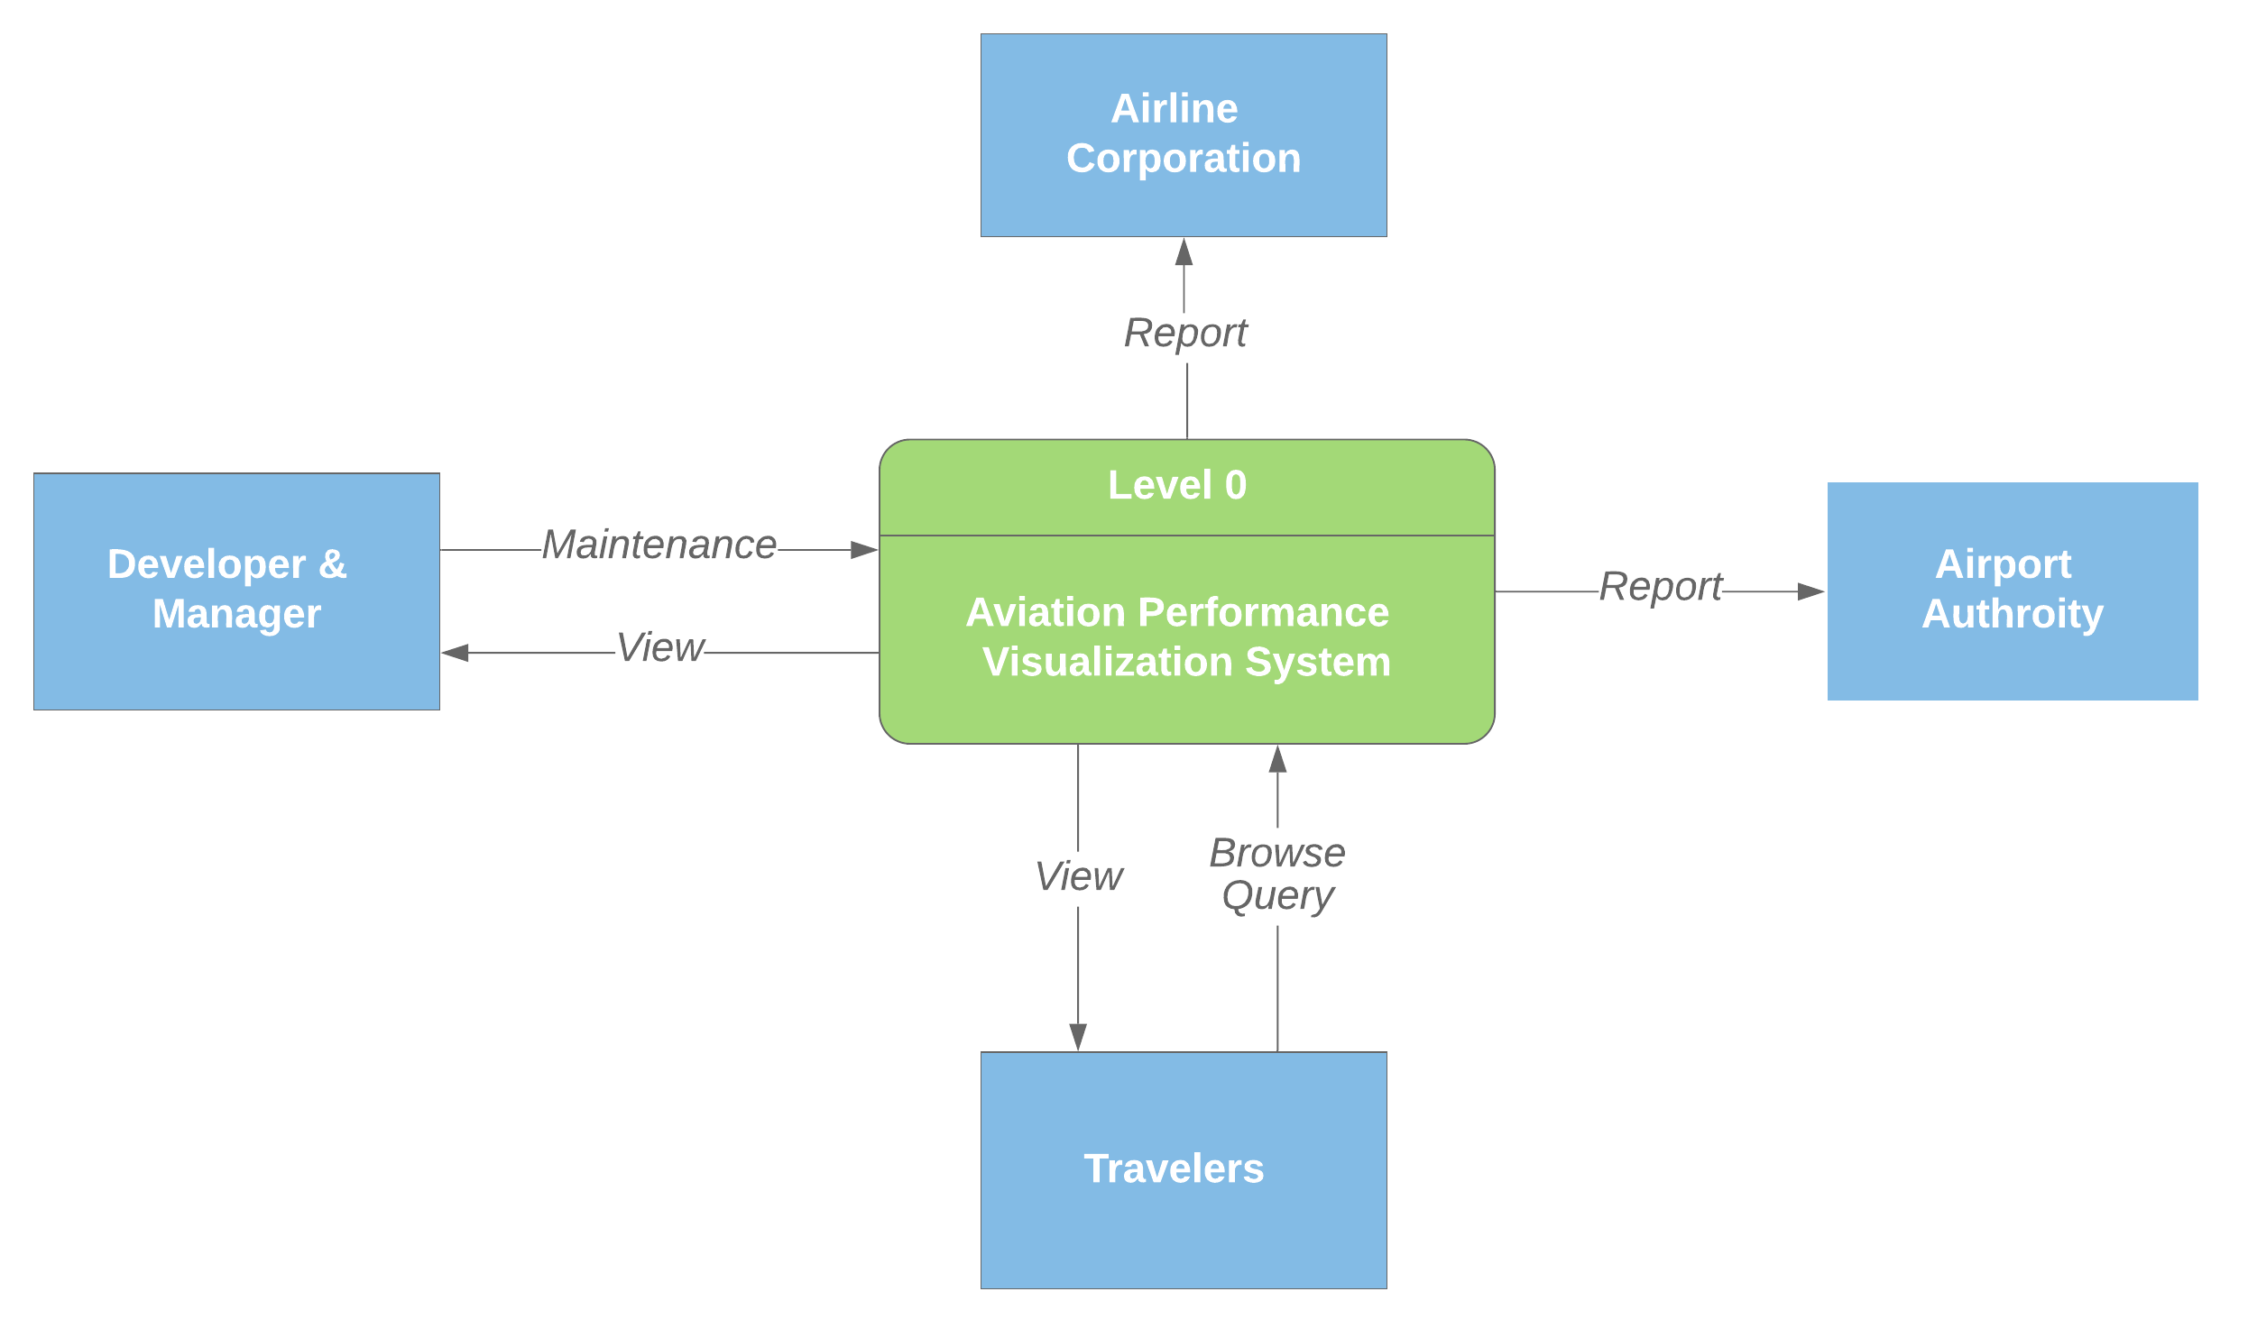
Context Diagram

Slide 9
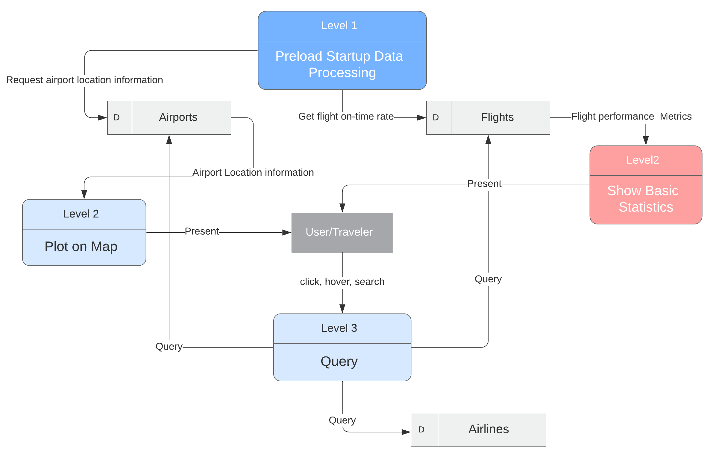
Dataflow Diagram

Slide 10
DEMO

Slide 11
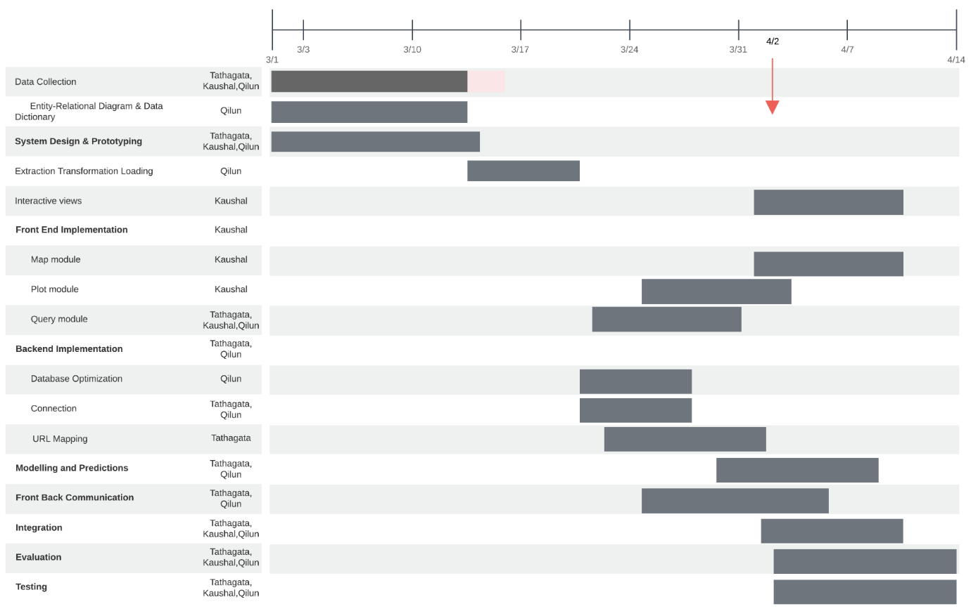
Timeline (Gantt Chart)

Slide 12
Future Work
Improvement of query performance
Implementation of Predictive Model
Cross filtering of views
Beautification of UI
Testing and Documentation

